Slide 1















Slide 2


Presentation on: Future Loan Predictions & Defaulters
An Overview
Prepared by – Sushrut Vyawahare
Aniket Pakhale
Shreyas Awati
Imarticus Learning Institute, Pune

Slide 3
Table of Content
Introduction
Problem Statement
Knowing The Dataset
Exploratory Analysis
Cleansing of Dataset
Variable Transformation
Correlation Plot
Feature Selection
Model Building
Conclusion

Slide 4
c
Introduction
In general, whenever an individual/corporation applies for a loan from a bank (or any loan issuer), their credit history undergoes a rigorous check to ensure that whether they are capable enough to pay off the loan (in this industry it is referred to as credit-worthiness).
Based on the amount of risk that the issuer is willing to take (plus some other factors) they decide on a cutoff of that score and use it to take a decision regarding whether to pass the loan or not. This is a way of managing credit risk.

Slide 5
c
Problem Statement
To build a data model to predict the probability, of default, and choose the cut-off on based on what we feel suitable.
Alternatively to use modelling technique which give binary output. Based on the data that is available during loan application , building a model to predict default in the future.
This will help the company in deciding whether or not to pass the loan.

Slide 6
Knowing the Dataset
Understanding the Dataset
These files contain complete loan data for all loans issued through the June 2007- Dec 2015, including the current loan status and latest payment information. The file containing loan data through the "present" contains complete loan data for all loans issued through the previous completed calendar quarter. Additional features include credit scores, number of finance inquiries, address including zip codes, and state, and collections among others. The file is a matrix of about 855969 observations and 73 variables

Slide 7
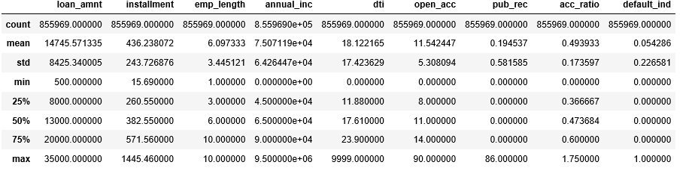
Knowing the Dataset
Checking number of Columns and Rows
print(loan_df)
(855969, 73)
Describe the Dataset

Slide 8
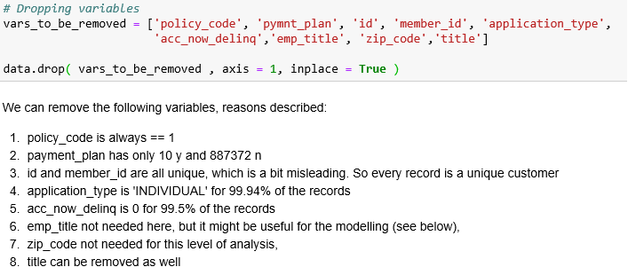
Exploratory Data Analysis
Dropping Unnecessary Columns

Slide 9
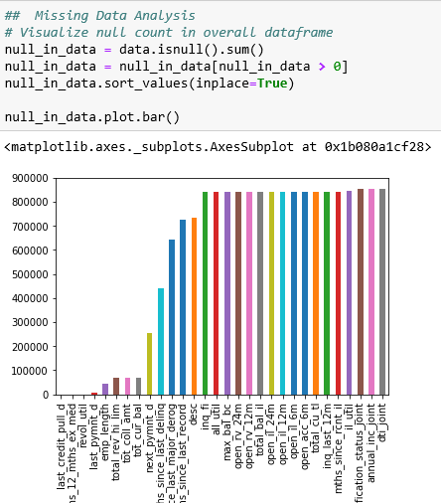
Exploratory Data Analysis
Checking Null Values
Cleansing of Dataset

Slide 10
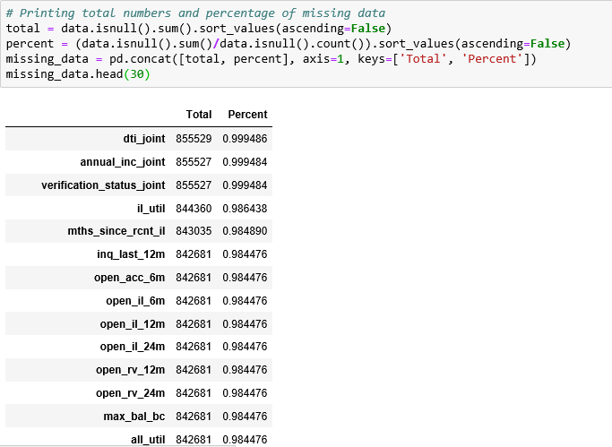
Exploratory Data Analysis
Cleansing of Dataset
Dealing with missing values
Columns having missing values greater than 75 % have been dropped.

Slide 11
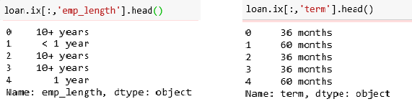
c
Exploratory Data Analysis
Variable Transformation
Following are the variables that needs to be transformed.

Slide 12
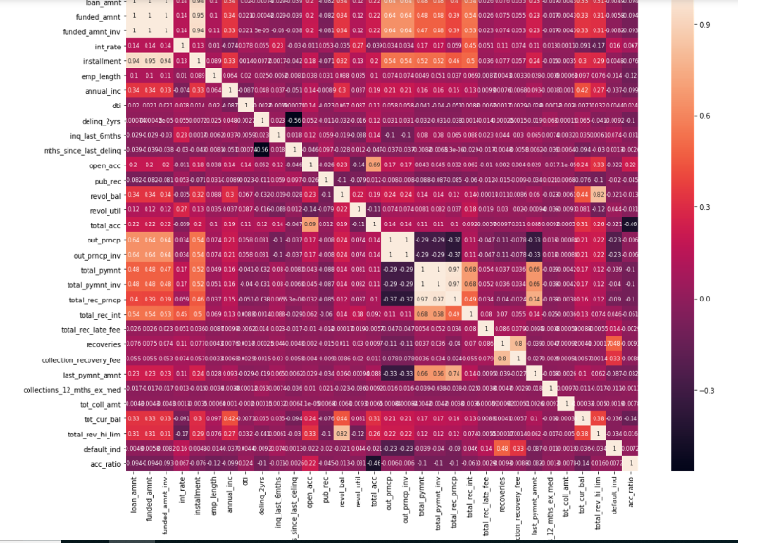
Exploratory Data Analysis
Correlation Plot

Slide 13
Finding the correlation between the variables
It can be seen from the plot above that loan amount and installment have a very high correlation amongst each other (0.94). This is intuitive since a person who takes a large sum of loan would require extra time to repay it back. Also, interest rate, sub grade and grade have a very high correlation between them. This is obvious since interest rate is decided by grades once the grades are decided, a subgrade is assigned to that loan (leading to high correlation).
There is need to set some threshold so we set for 0.3 to -0.3 for the better performance of model. A feature selection is done on based on this threshold.

Slide 14
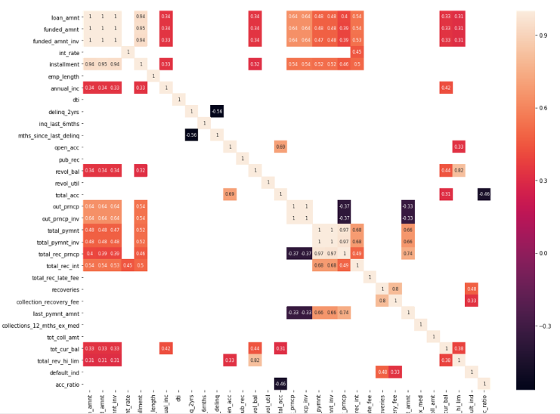
Exploratory Data Analysis
Correlation between feature selection (0.3 to -0.3)

Slide 15
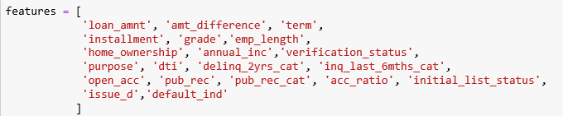
Feature Selection
Selecting important variables
Following are the 20 features which we select based on the threshold as shown in above correlation plot.

Slide 16
Model Building
Splitting Dataset into Training and Testing
We have given certain condition in our problem statement based on which we have to divide our train and test data set.
Following is the condition:-
We split the dataset based on ‘issue_d’
Train set - (June 2007 - May 2015) Test set – (June 2015 – Dec 2015)

Slide 17
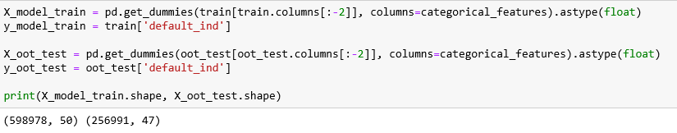
Model Building
Creating dummy variables
Model Building
Logistic Regression
Random Forest

Slide 18
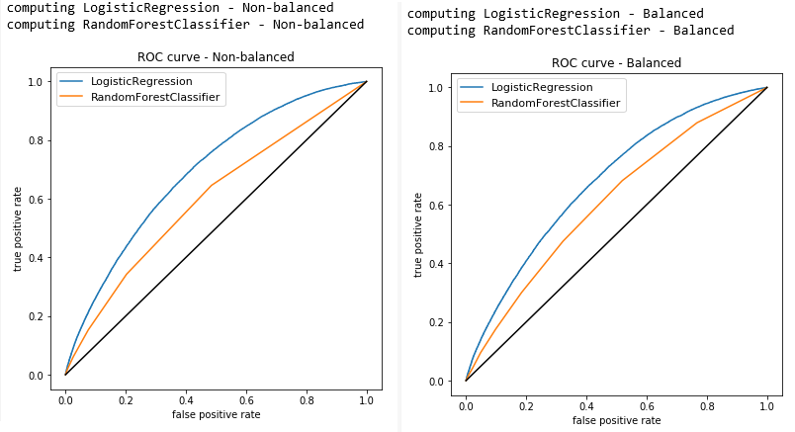
Results
ROC Curve

Slide 19
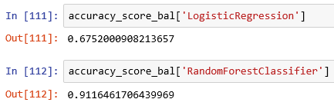
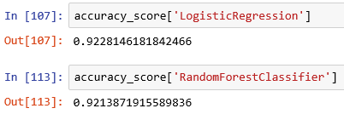
Conclusion
Balanced
Non-Balanced

Slide 20



Imarticus Learning Institute, Pune

